Slide 1

Handwritting Recognition
CE4171 – IoT – Communication & Networking
Project
Tan Kah Heng Darryl

Slide 2

Problem
Often times, handwritten documents needs to be translated to softcopy to fill up forms or translate it to a word document.
However, one needs to photocopy or manually type in. Others might not be able to read your handwriting and manually typing in will be time consuming.
Problem becomes a deep learning image classification problem.

Slide 3
Components of the handwritting application software
01
02
03
04
Flutter
Flask
Develop Android App
Creates the backend to receive images and handle multiple requests HTTP protocol
Tensorflow
Google Cloud
Creates the deep learning model and perform inference
Stores Flask and Tensorflow backend and stores all received images and resultant images

Slide 4
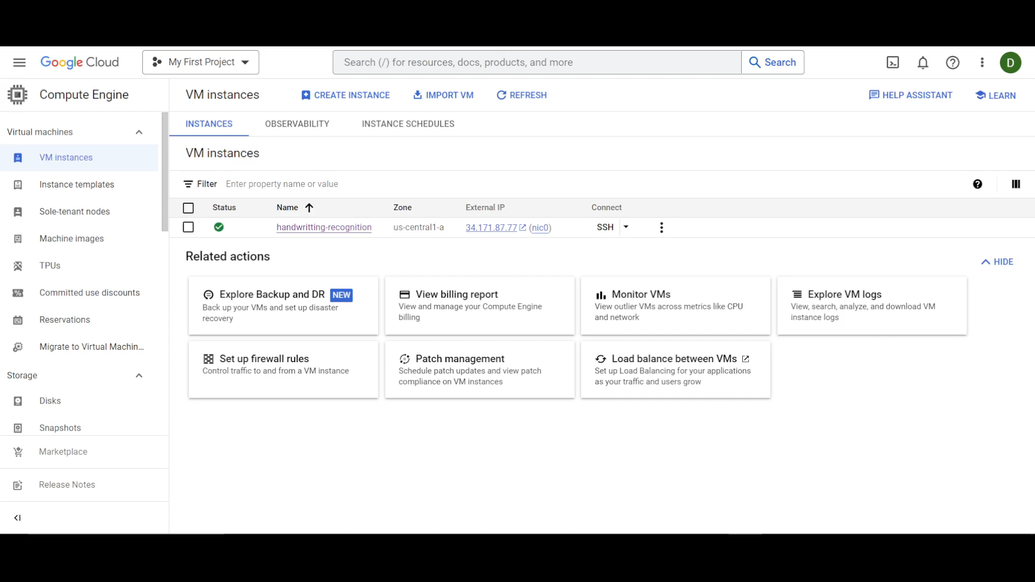
Demonstration

Slide 5
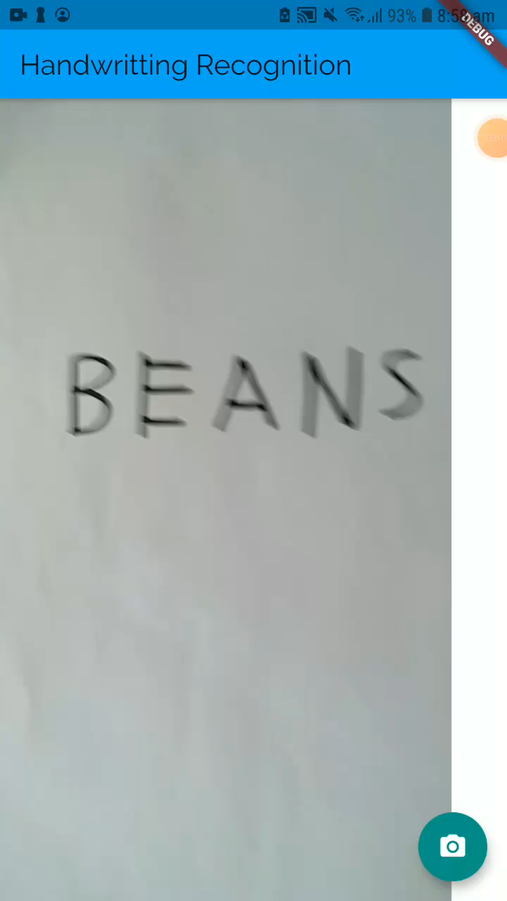
Demonstration

Slide 6
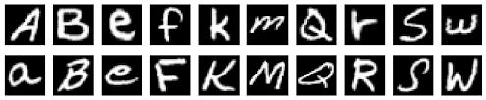
Dataset Used
The model is trained with the EMNIST dataset, but only involving the 26 letters with 145,600 characters.

Slide 7
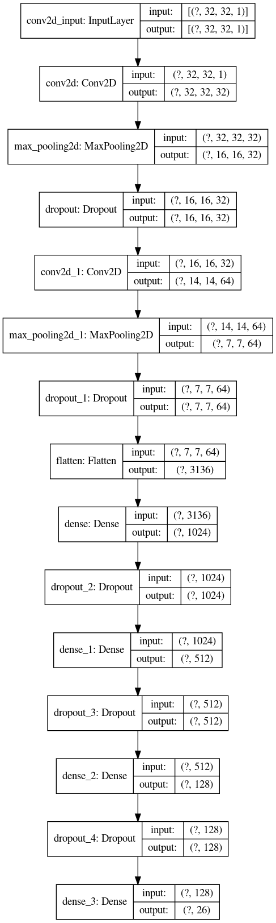
Model Used
I created my own model.
Model Structure:
2 convolution layers with maxpooling and dropout
3 Fully Connected layers, each with its own dropout layers
Training Accuracy: 96.5%
Testing Accuracy: 93.6%

Slide 8
Tasks Completed
Collect Input
Run Inferrence in cloud
Run on Android
Flutter application opens camera app to take real-time photos
Cloud stores Flask and Tensorflow to run deep learning inferrence
Flutter application designed and deployed on Android
Communication
Train Own Model
Support Multiple Users
Photos are sent to the cloud and the cloud sends back result to phone
Own neural network model trained using EMNIST dataset
Supports multiple users using Flask and HTTP protocol

Slide 9
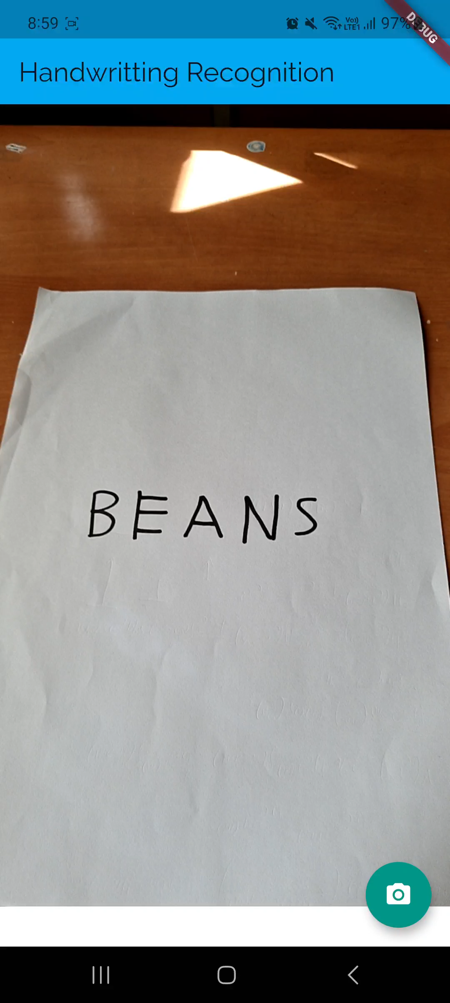
Supporting Multiple Users

Slide 10
Supporting Multiple Users

Slide 11

Thanks!

